Slide 1
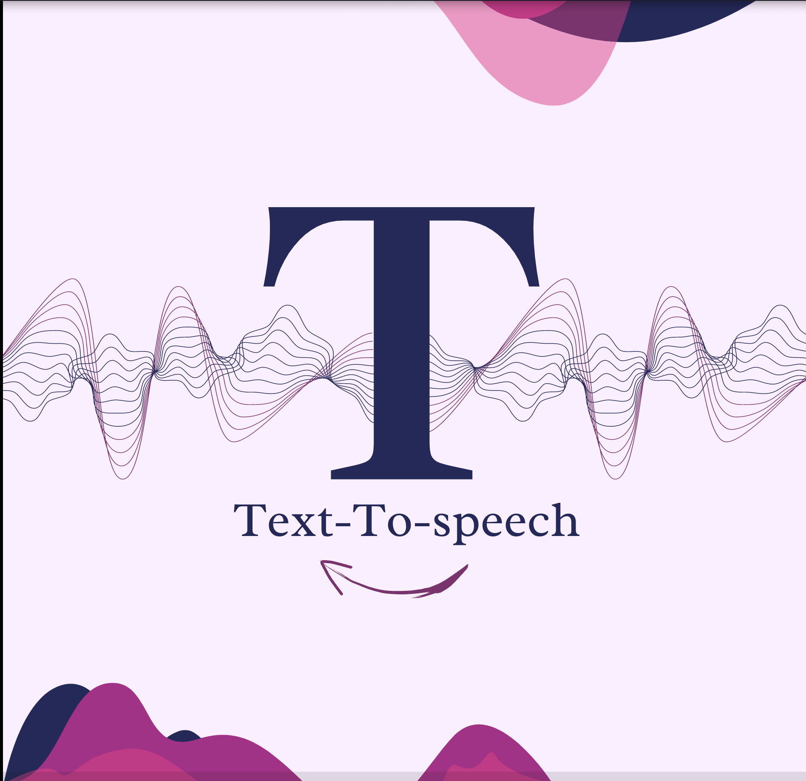
Text-to-speech & Speech-to-text System

Slide 2

Concept
Text-to-speech:
It’s a type of assistive technology that reads digital text aloud
Converts an input sentence which is usually a sequence of letters or symbols into machine generated speech
Speech-to-text:
It’s a speech recognition software that enables the recognition and translation of spoken language into text.
Speech recognition use computer algorithms to process and interpret spoken words and convert them into text
This web application also contains a translator for the user to translate any text if needed, and an image to text convertor if the user need to translate any text from an image.

Slide 3
Technology
This project is developed using visual studio code
The programming language used is JavaScript
SpeechSynthesisUtterance: Its an interface of the Web Speech API and it represents a speech request. It contains the content the speech service should read and information about how to read it (pitch,volume). It is also used in the translator when the user click the speak button
Web Speech API: The Web Speech API enables us to incorporate voice data into web applications. It has two parts SpeechSynthesis and Speech Recognition
MyMemory: is a REST API used in translator It’s similar to Google Translate API, extended with MyMemory specific parameters and lets you search and contribute to MyMemory archives.
Tesseract.js OCR(Optical Character Recognition ): is an open-source text recognition engine that allows us to extract text from an image.

Slide 4
Contribution
Text to speech helps people with difficulties to communicate with others
Text-to-speech is very helpful for kids who struggle with reading
Speech-to-text helps people improve communication skills
Text from image extractor helps the user to copy any text from any image which saves time instead of typing it.
Text from image extractor helps the user if he/she wants to translate text from an image.

Slide 5
Problems Encountered
Problems in time management
Problems in code development: Downloading extensions and bug fixing
The project was supposed to be a mobile app using python, it was changed to a web-based app using JavaScript due to problems in downloading python extensions in visual studio code

Slide 6
Capstone
Competency | Course
Website Design | Web Programming(CSIS228)
Creating functionalities in website | Web Programming and Advances in Computer Science(CSIS228 & CSIS279)
In this project I used what we have learned in the Advances in computer science course and the web programming course in order to complete the project.

Slide 7
Future Work
Develop a mobile app alongside to the web app
Adding more languages to the speech to text system
Adding a feature in my app that detect bad words or words related to racism and prevent it from typing it or converting it into speech,and also detecting suicidal words and the app sends a message for the user to contact any help resources
Adding a speech emotion recognition which recognize the emotion of the user based on his tone and pitch

